Slide 1


Women
for women

Slide 2




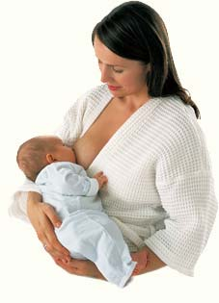
The idea was born from experiences
at the Sant’Anna Hospital in Torino
Of those who work there every day and who asked themselves what else they could do…
to provide a better response to women’s desires and expectations
Of those who came to Sant’Anna as patients or visitors and who felt satisfied with
the medical services offered but…
thought something was missing in the facilities

Slide 3
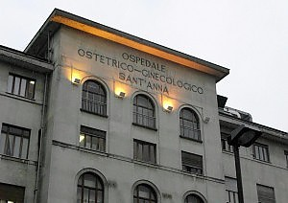

Sant'Anna Hospital
The biggest Obstetric and Gynaecological Hospital in Europe
244 OBGYN
Hospital beds: 432
188 neonatology
Average number /year:
deliveries
8.535
OBGYN surgical operations
10.392
ER consultations
89.103
Highly specialized out-patient services
578.571

Slide 4

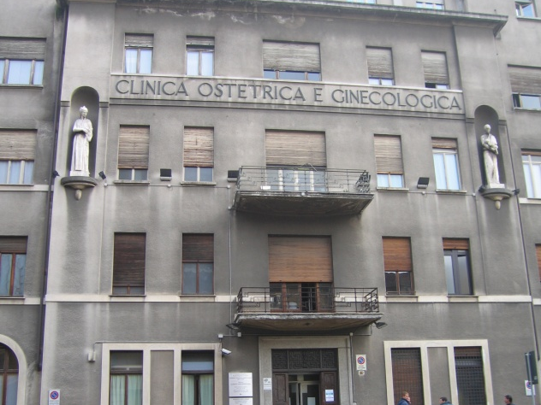


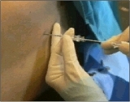
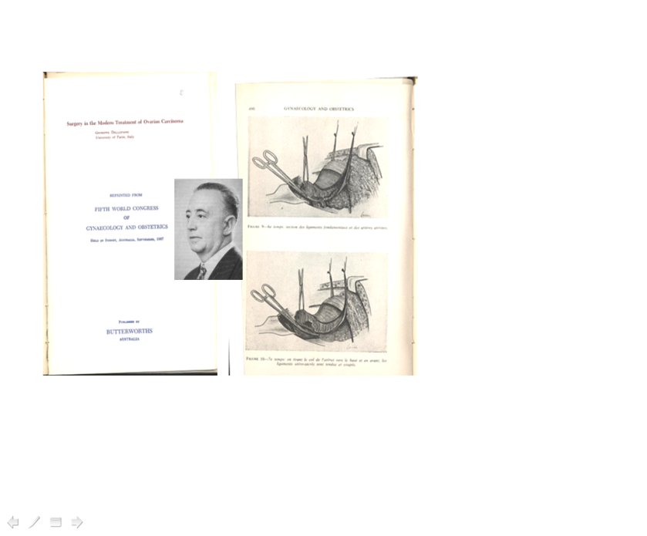
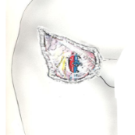
The Sant’Anna Hospital and Turin
Home to many breakthroughs and records in OBGYN
1728 First School of Obstetrics in Europe
1967 first Anaesthetics and Analgesic Service in Italy dedicated exclusively to OBGYN
Innovative surgical techniques for tumors
of the ovary (1967) and of the vulva (’80s)

Slide 5
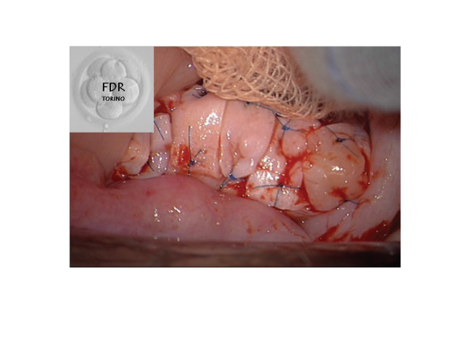
1982 Sant’Anna was defined as
the biggest cradle in Europe
1984: first in vitro fertilization (FIV)
in a public Italian hospital
2010 first re-transplantation of cryopreserved ovarian tissue in Italy
2012 first delivery after ovarian re-transplant in Italy, and one of the few in the world

Slide 6
Objective
To work side by side with public institutions
concerned with health care…
…to transform hospitals into places where women feel comfortable, cared for and safe,
hospitals which meet women’s needs and expectations to the fullest
Rethinking the old concept of hospitals, starting from women’s point of view and their needs
Making hospitals into friendlier places which guarantee the highest levels of patient safety
Supporting scientific and technological research
Promoting professional growth and excellence among health professionals and volunteers who work there

Slide 7

The Foundation intends to create, support, organize
and finance projects, events and activities
useful to ensure that
Science, Technology and Art
be placed at the service of
women in need of care.

Slide 8

The first step of the Foundation…
To listen to the needs and expectations of those within the Hospital
6 focus groups were set up with the following participants:
In-patients pregnant and puerperal women
  Midwives and nurses
In-patients with gynaecological pathologies
  Gynaecologists
Gynae-oncological patients
  Trainees in OBGYN and midwifery students

Slide 9




Technological and scientific excellence
DOES NOT MATCH
with the architectural settings.
PERCEIVED NEGATIVE PSYCO-EMOTIONAL
«FEELING OF COLDNESS»
GREY
“GREY FACADE…GREY BUILDING…
…GREY INTERIORS…”
“

Slide 10
The first step of the Foundation…
To listen to the needs and expectations of those within the Hospital
6 focus groups
Ideas and suggestions for
IMMEDIATE ACTIONS
*
  Doing away with the colour grey by introducing warm, welcoming colours
*
Introducing green areas both inside and outside the hospital
*
Improving the internal pathways and adopting clear and legible signs
in order to reduce the degree of disorientation
*
Making people’s stay more comfortable and facilitate their privacy
*
  Adopting differentiated interior decorations, each suited to the various
  therapeutical spaces

Slide 11

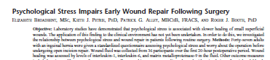
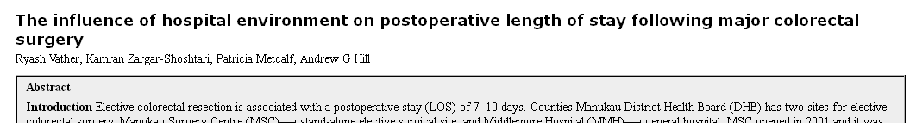
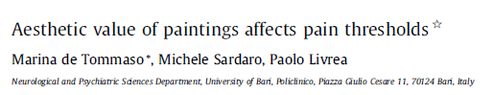
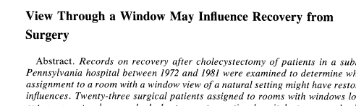
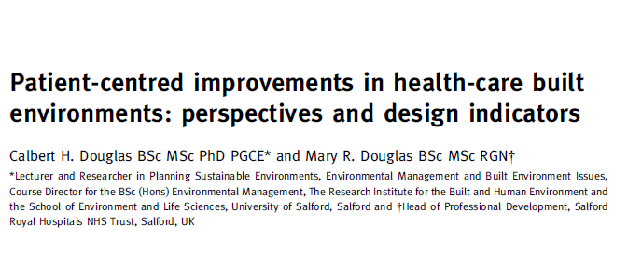
All this must not be
looked upon simply as a “mere structural decorative facelift”
Clinical experiences have shown
how a pleasant environment
positively influences the care process

Slide 12


Scientific evidence shows that
a comfortable environment and the view of pleasant images are able to:
reduce the perception of pain and the time of hospitalization,
promote post-operative recovery and
accelerate the process of wound healing

Slide 13











ART & HEALTH PLATFORM

Slide 14
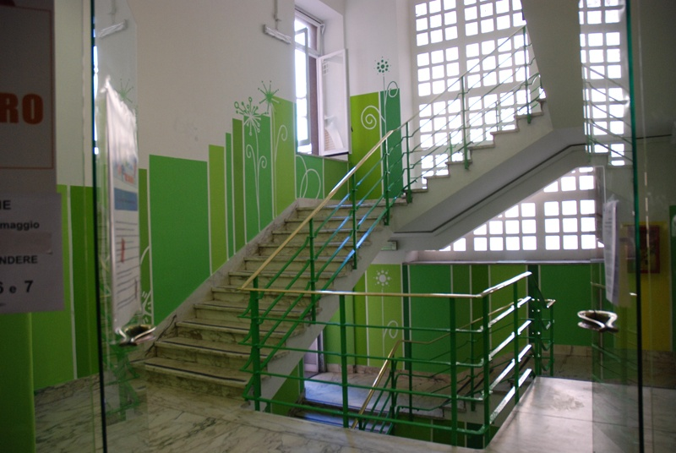
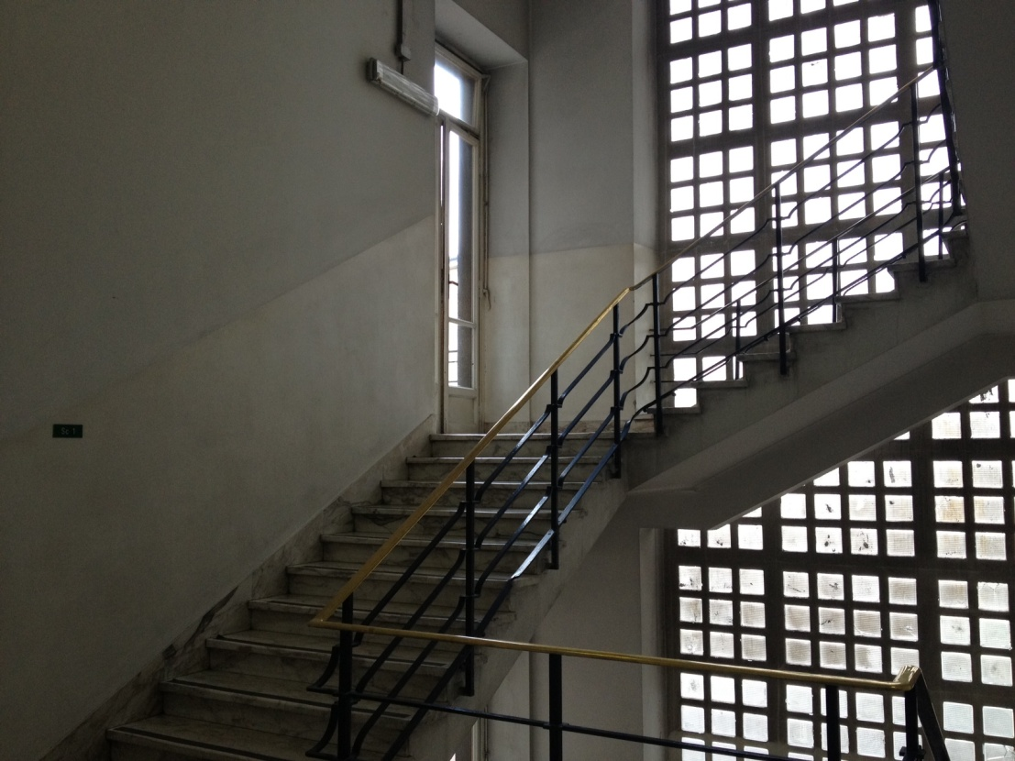

Slide 15
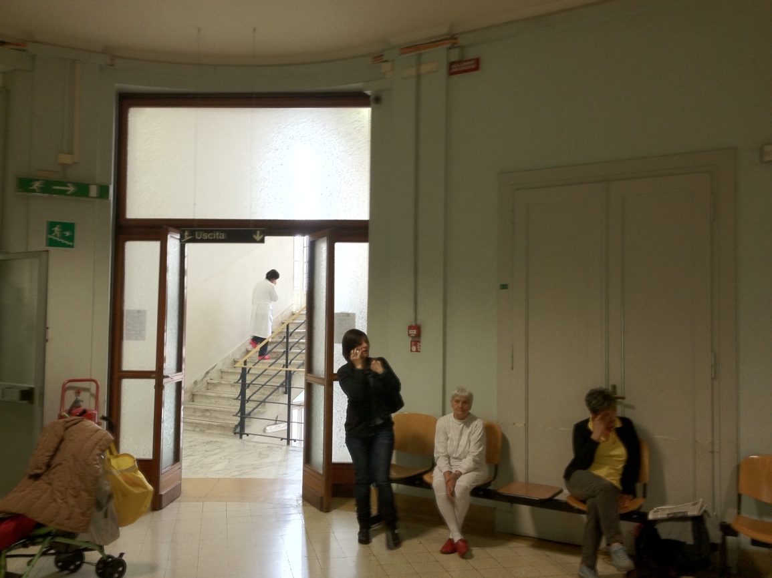
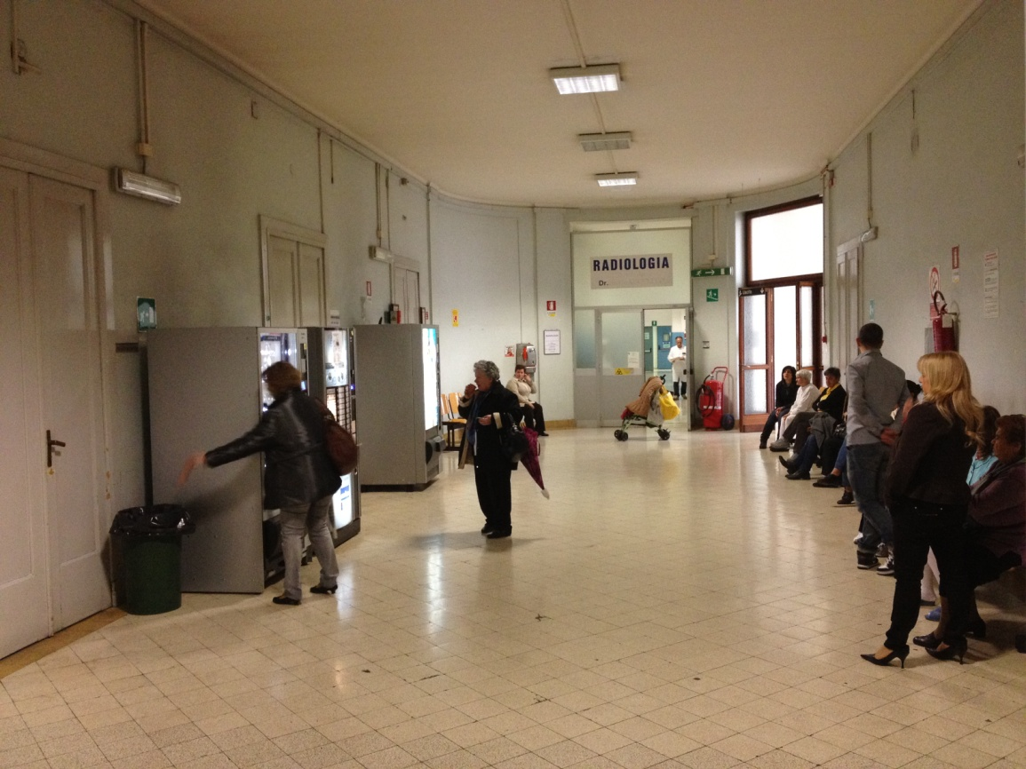
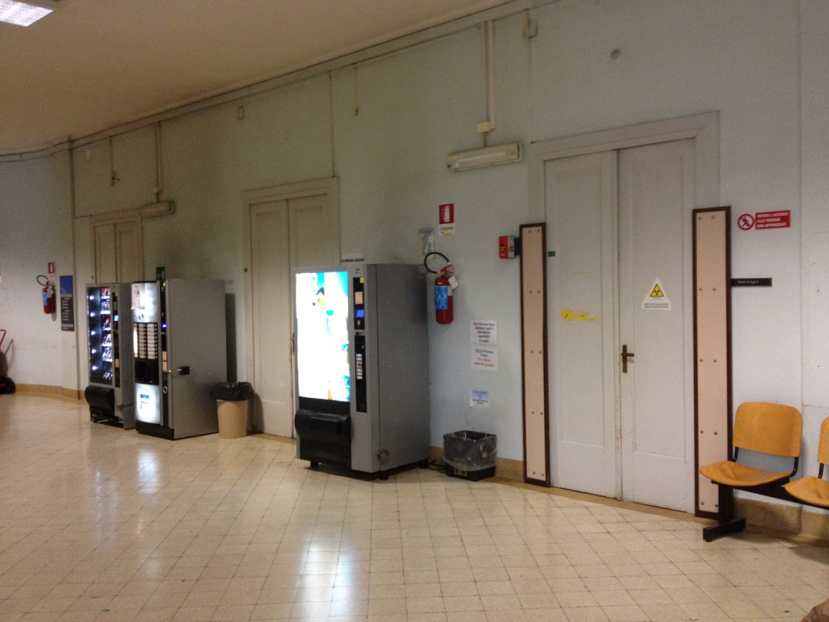
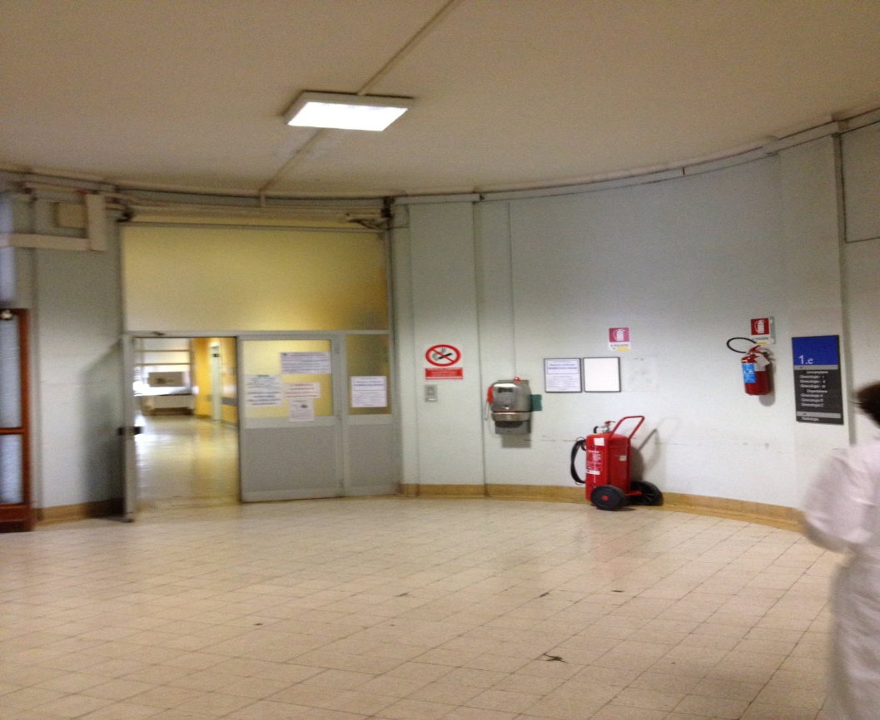

Slide 16
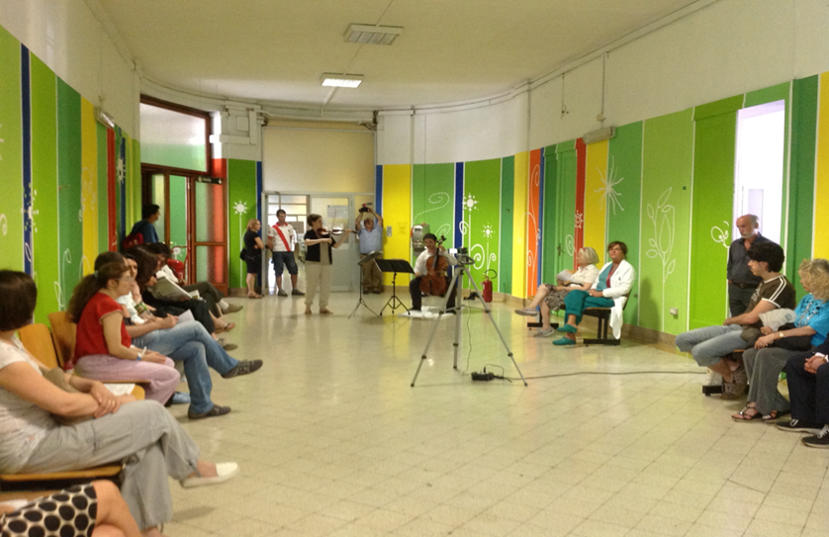

Slide 17
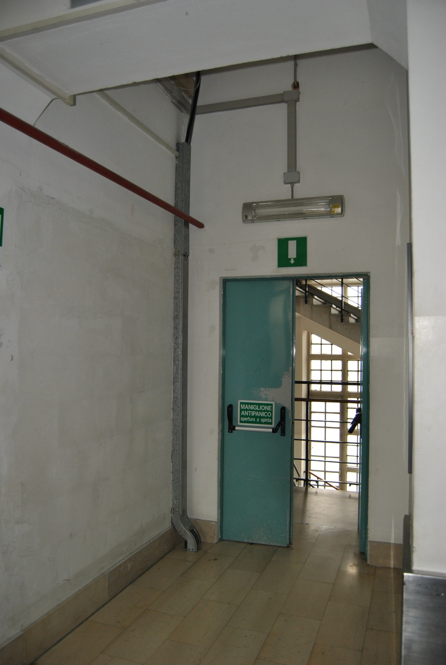
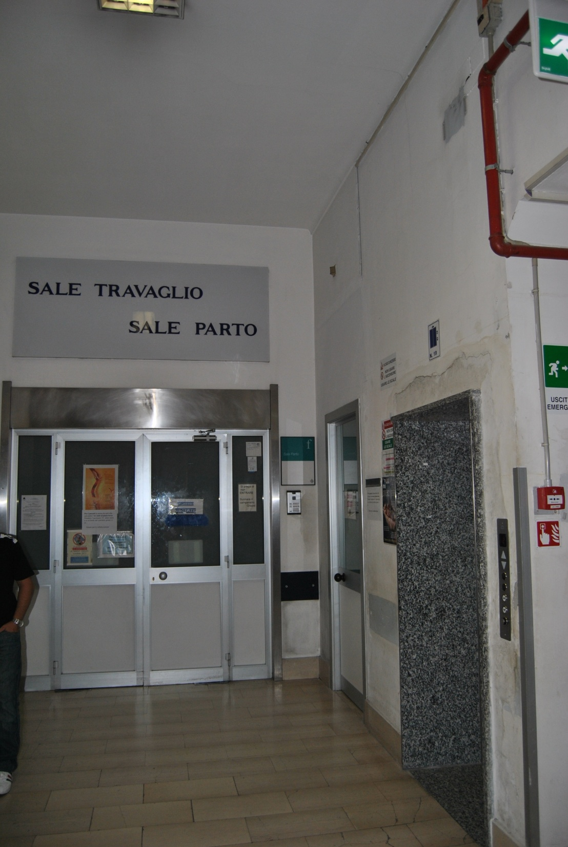

Slide 18
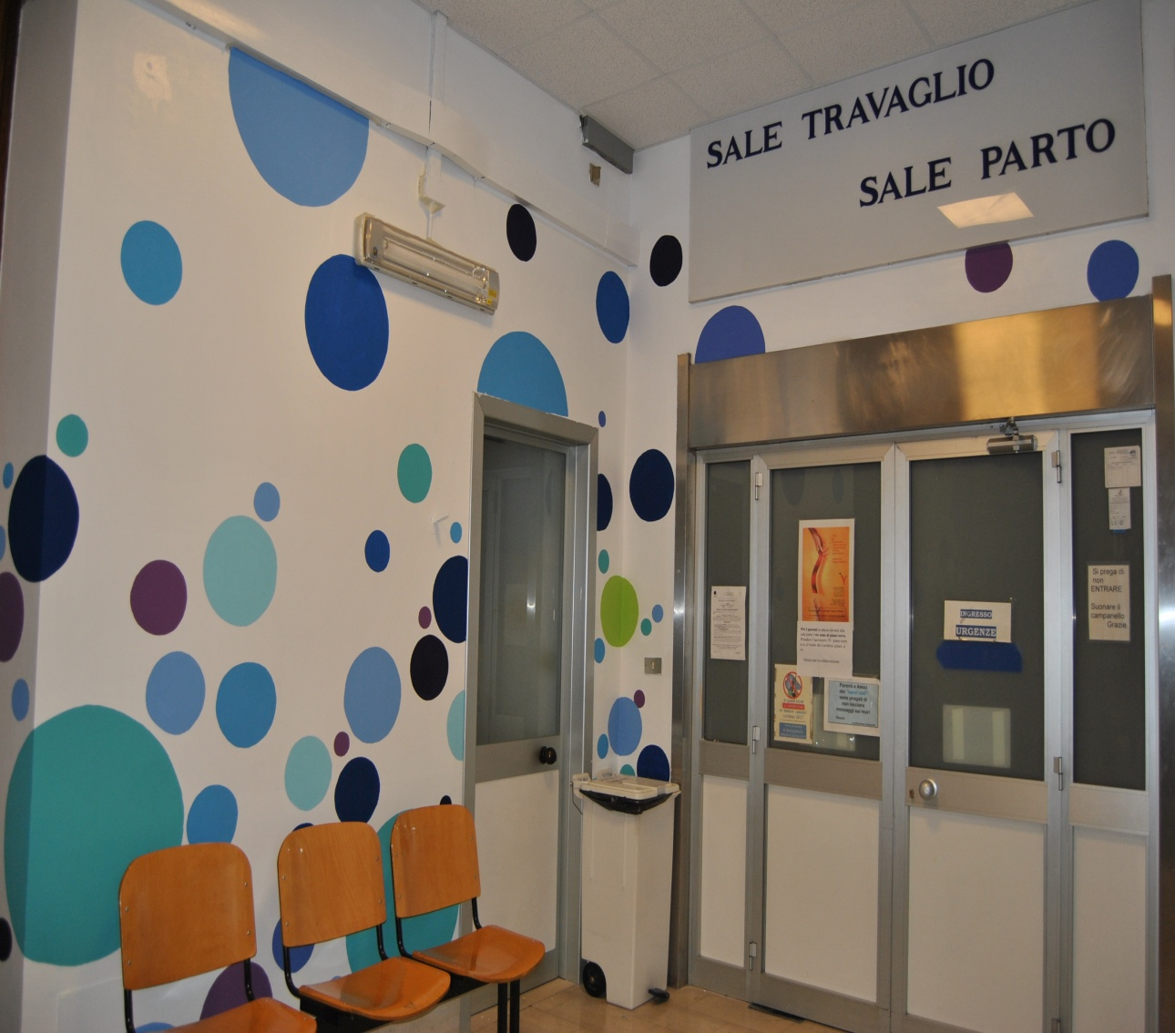
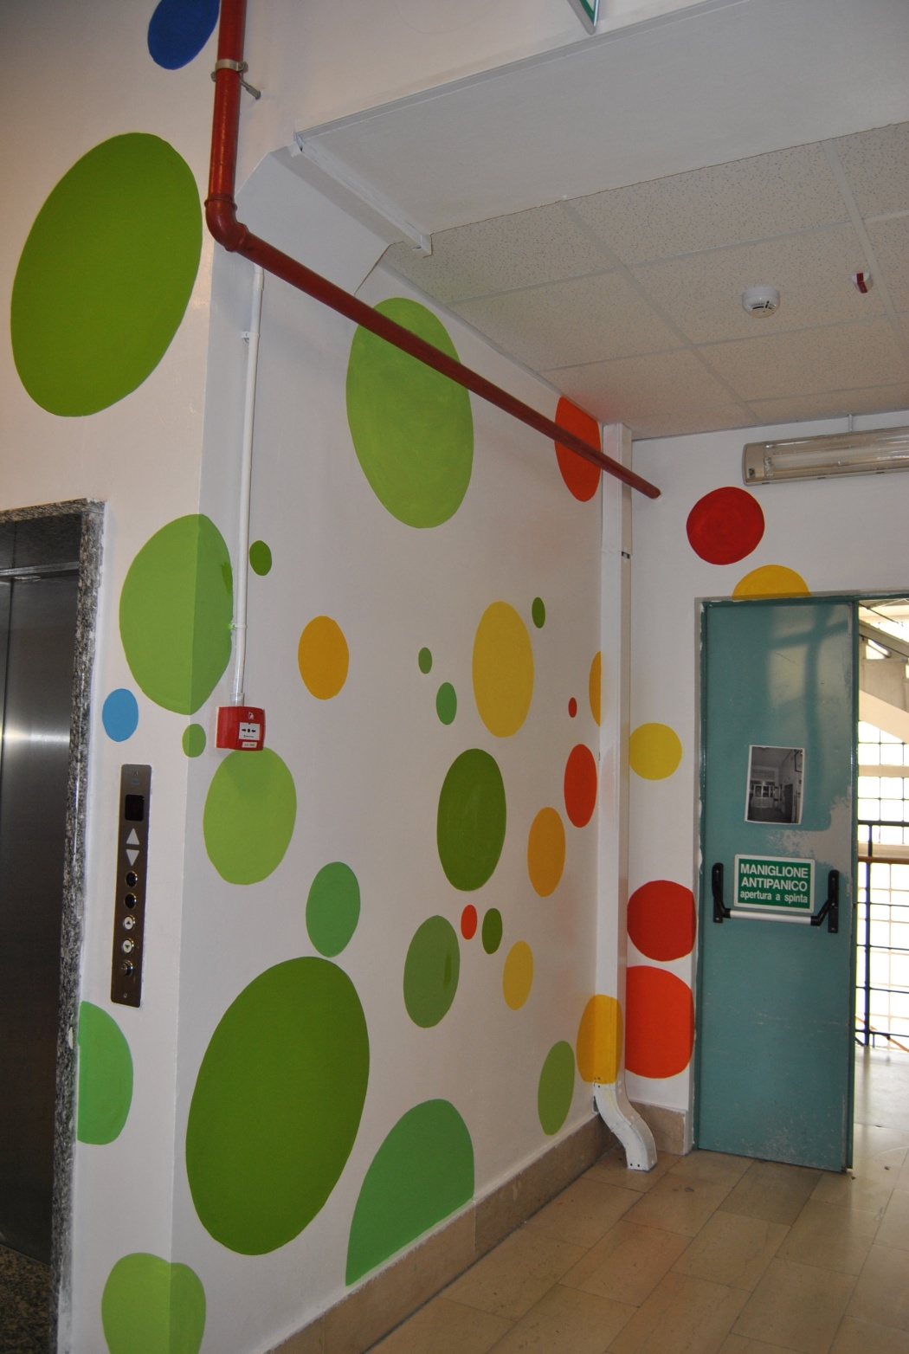

Slide 19
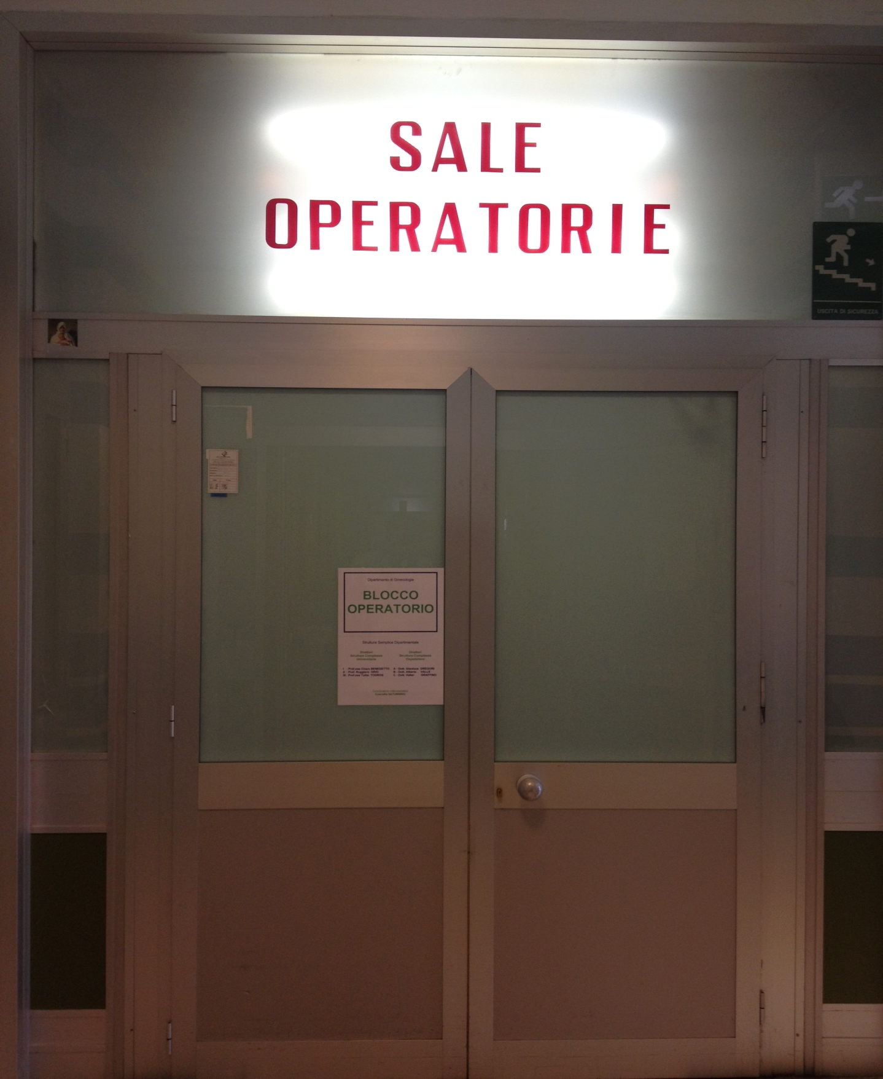

Slide 20
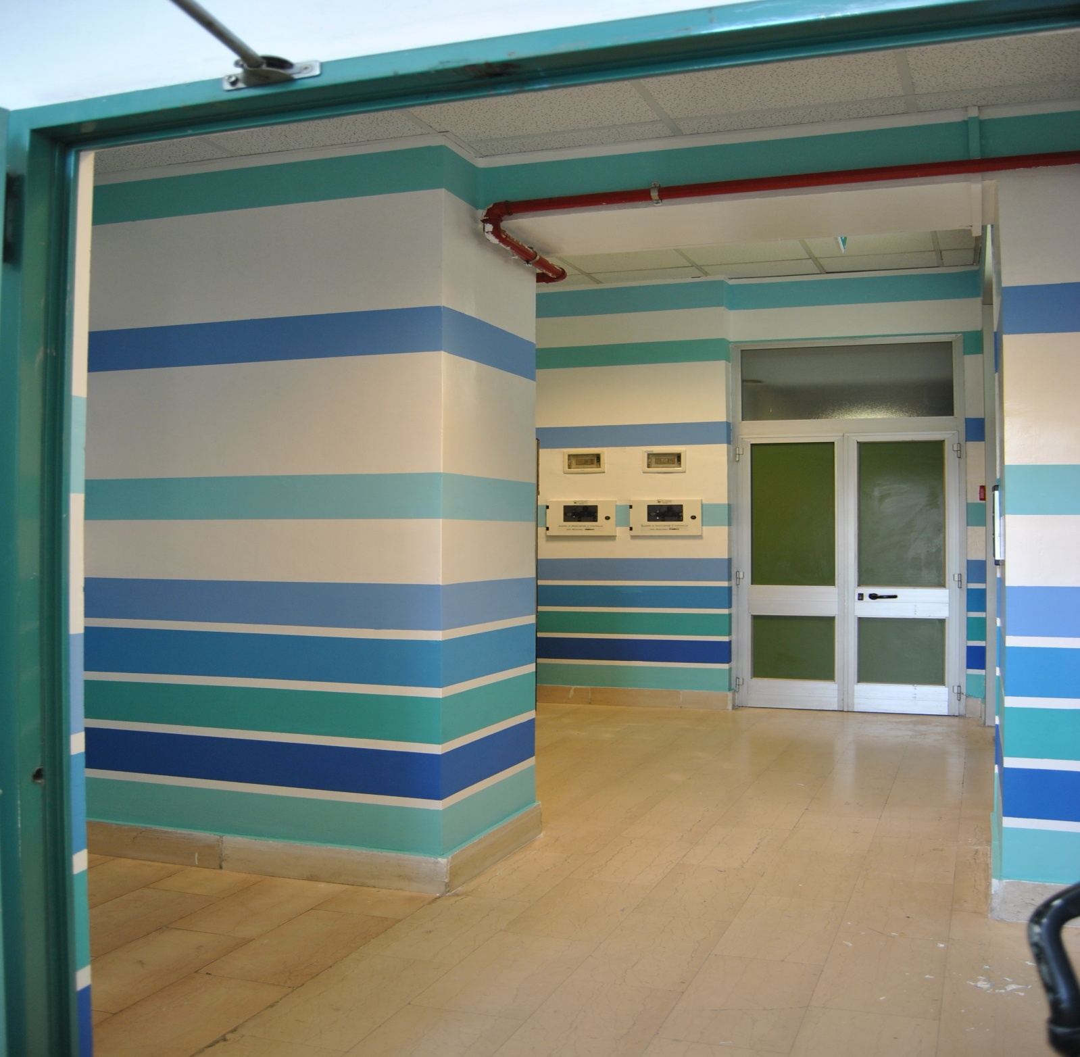
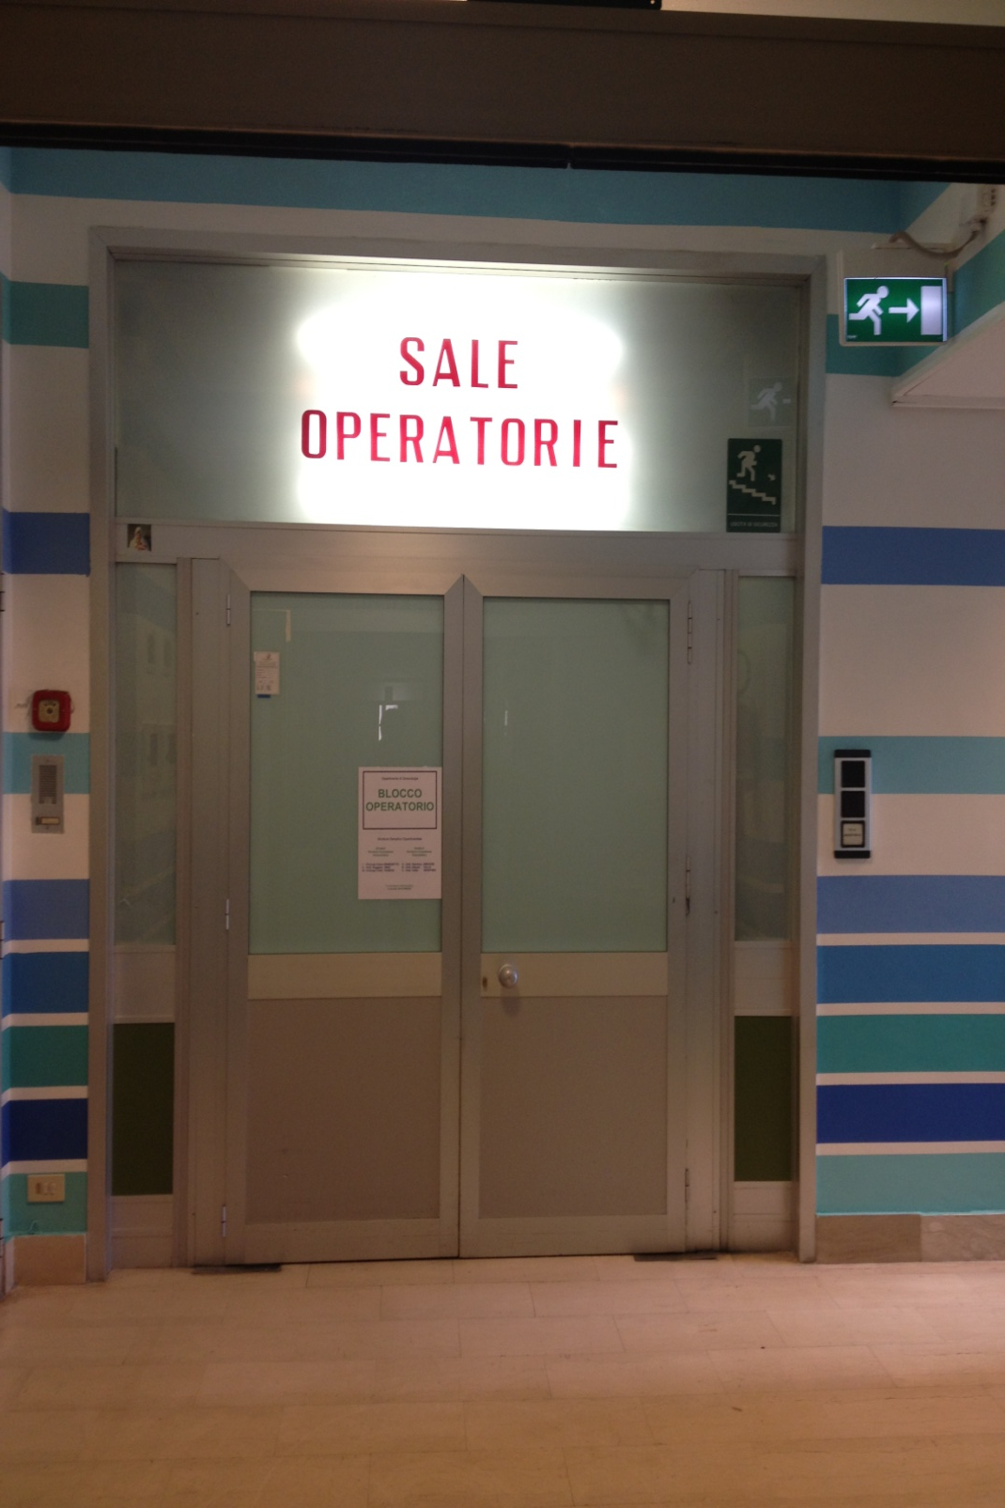

Slide 21
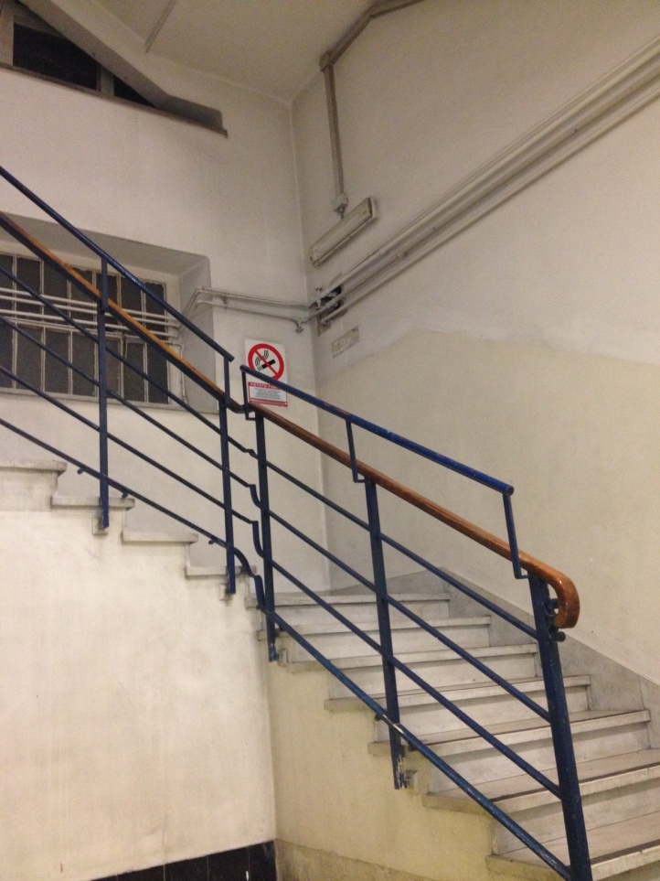
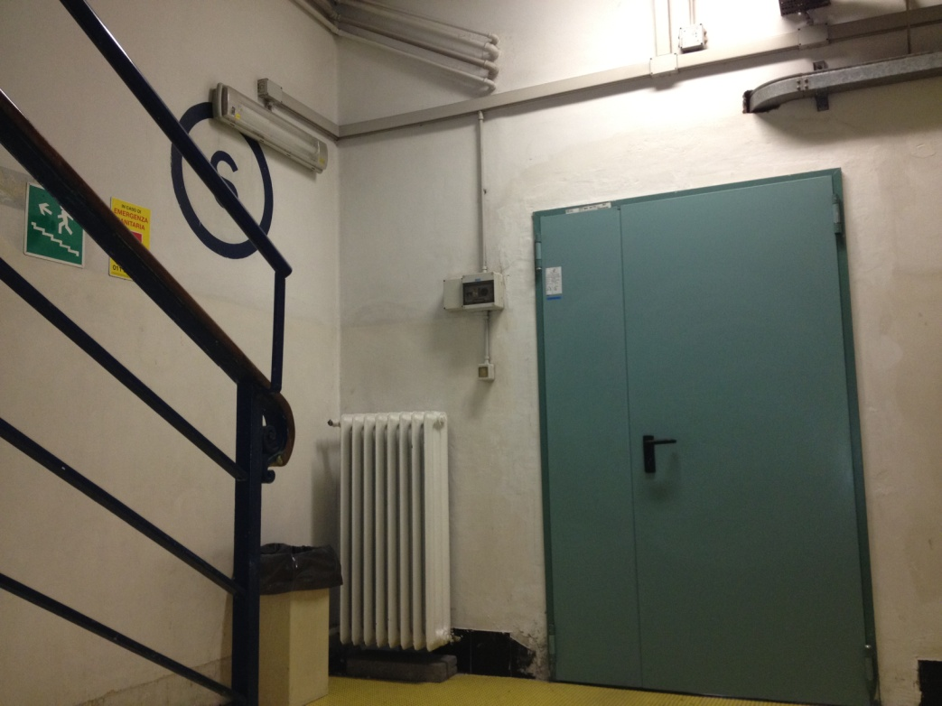
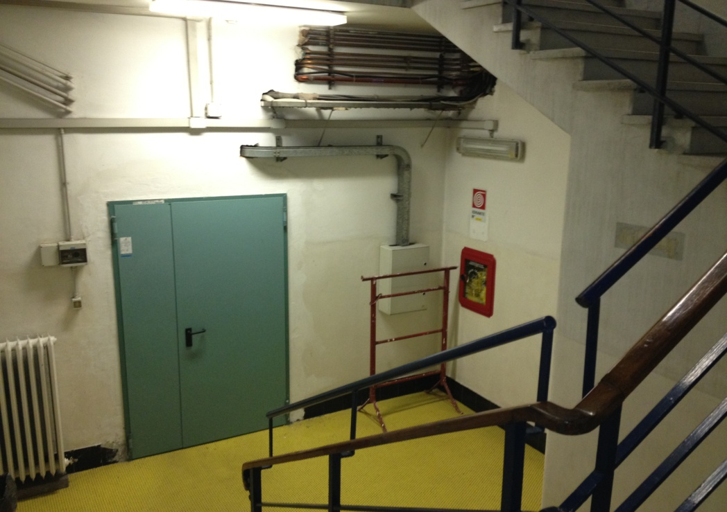

Slide 22
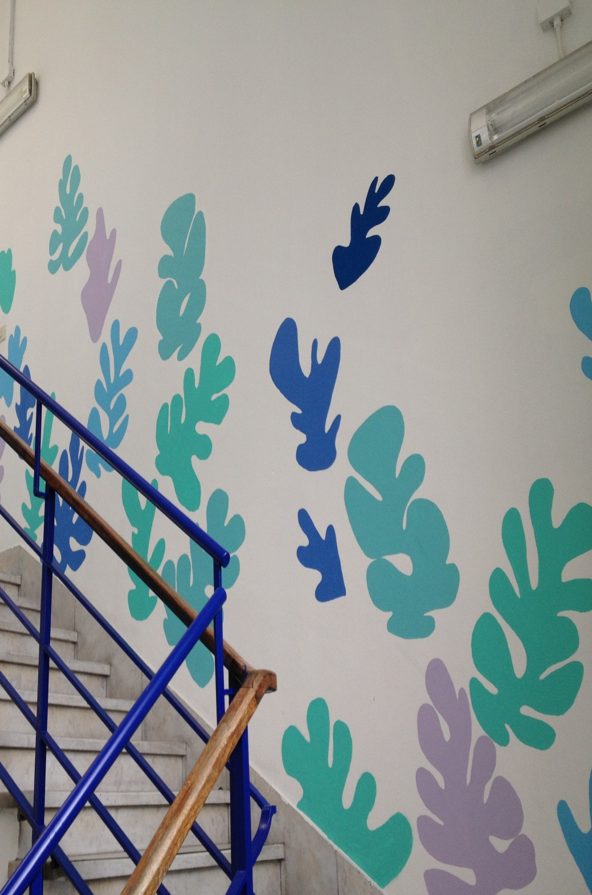
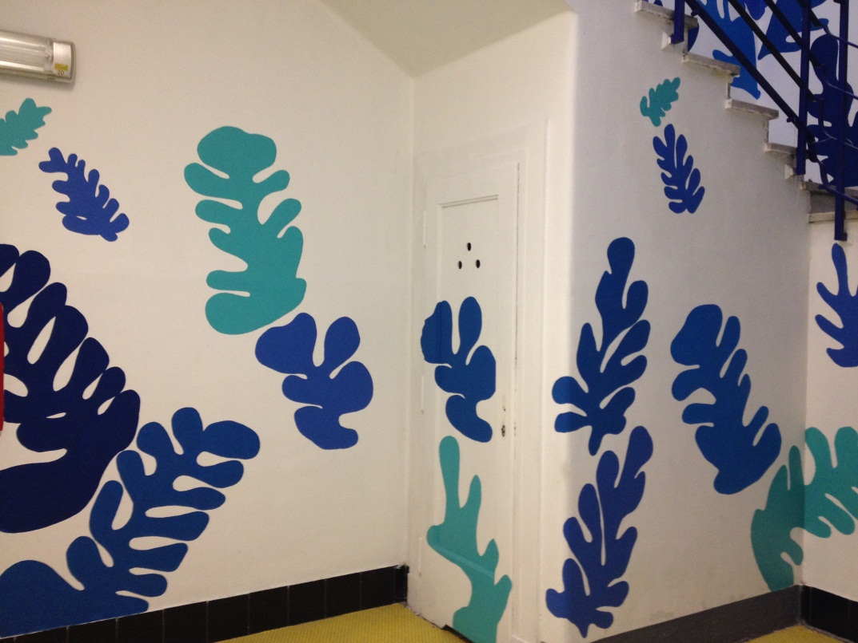
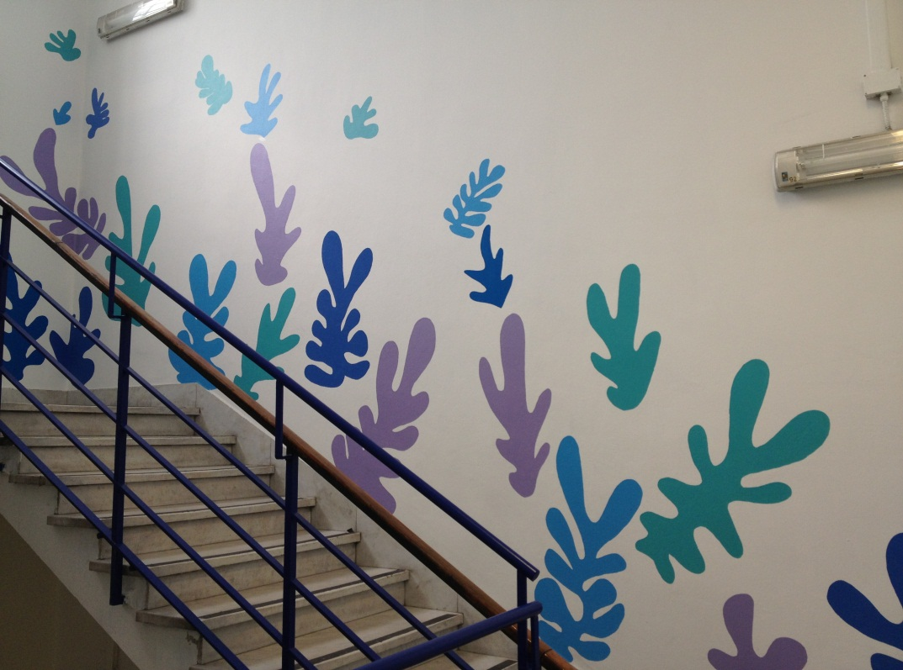

Slide 23
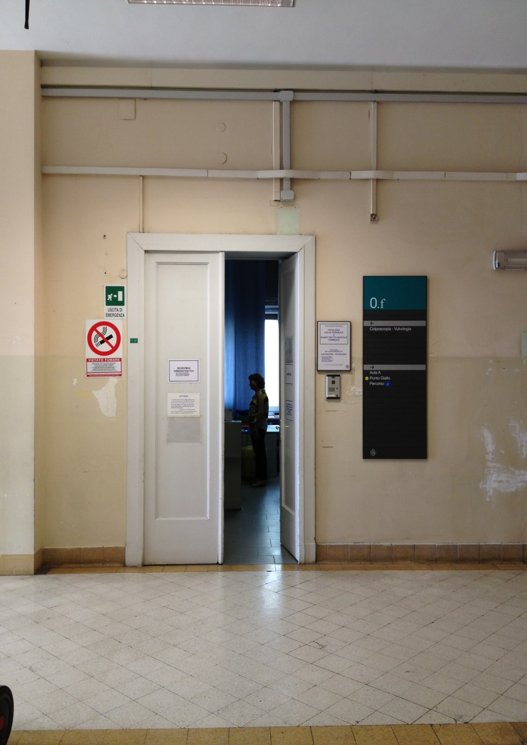
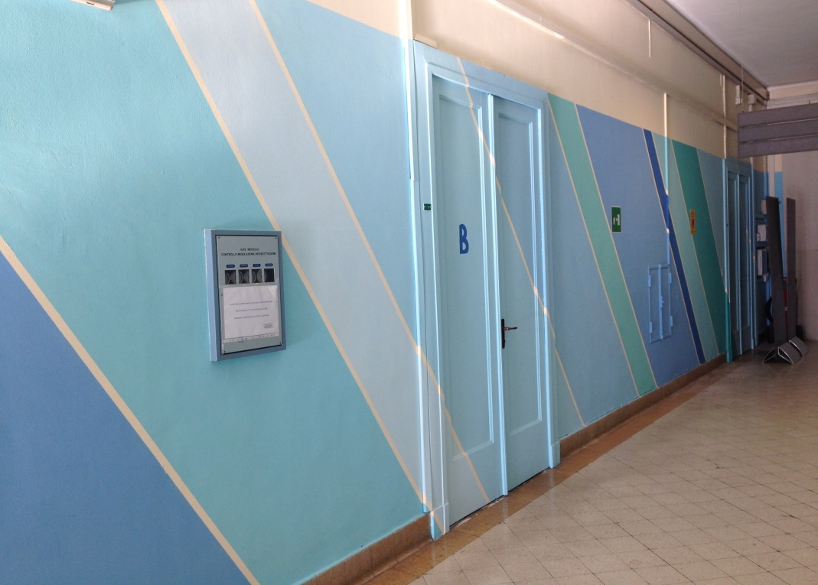
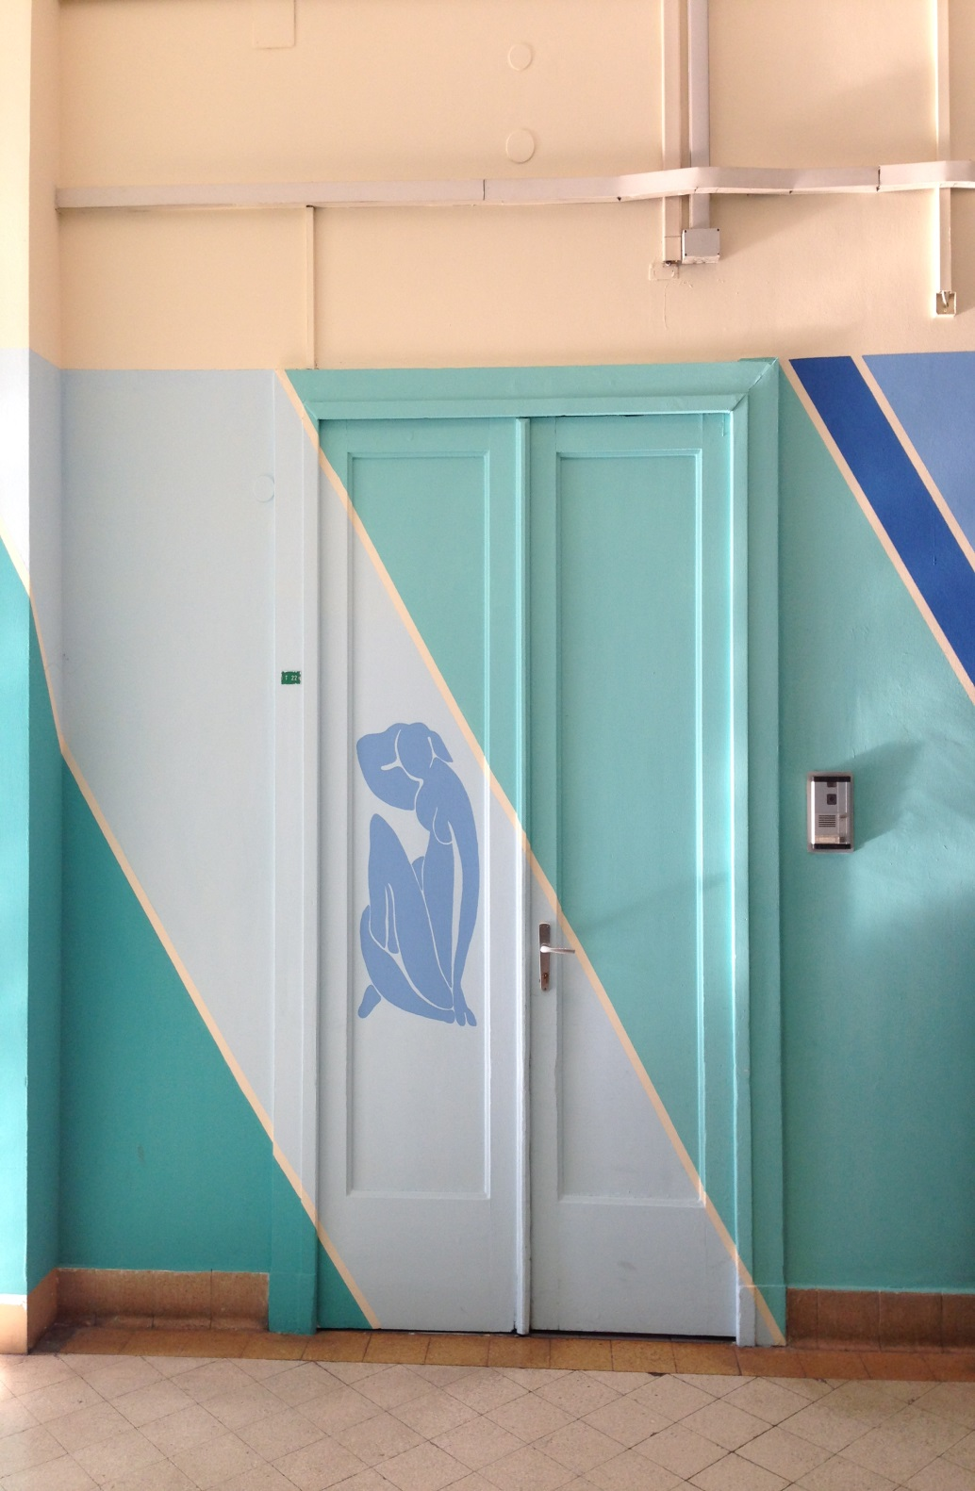
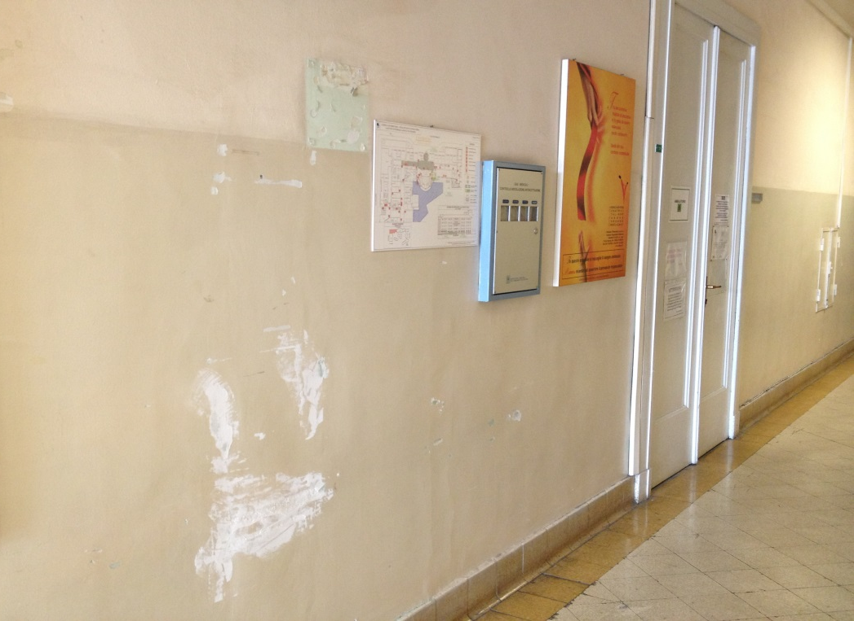
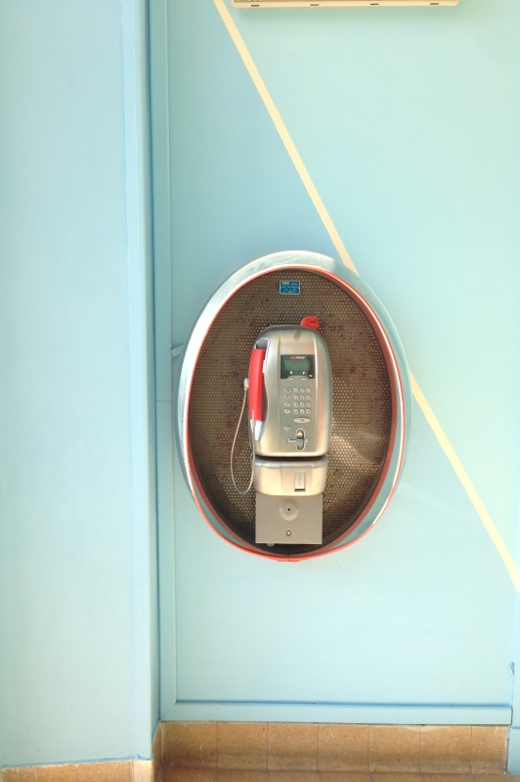
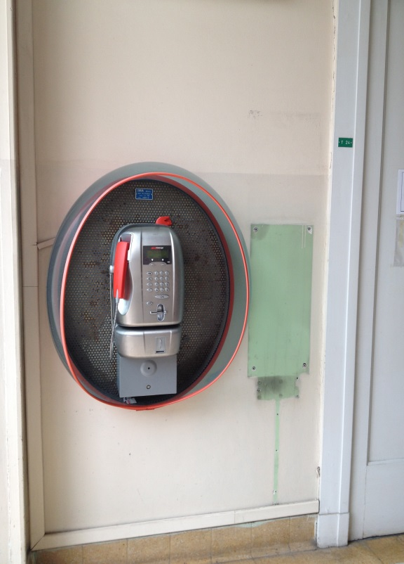
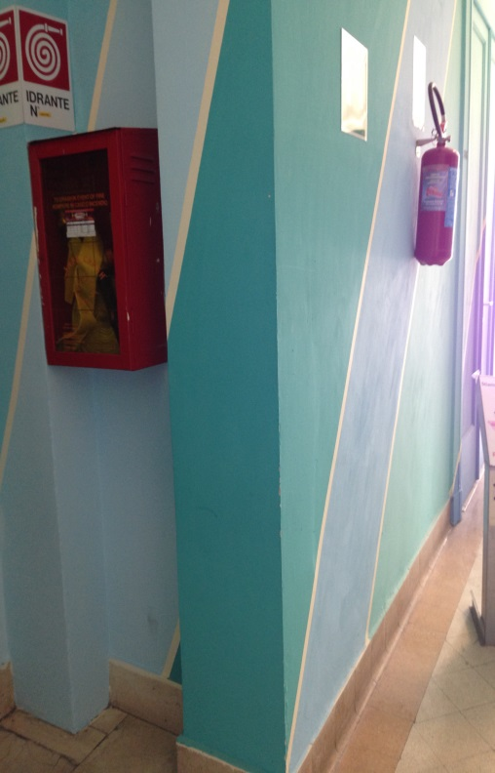
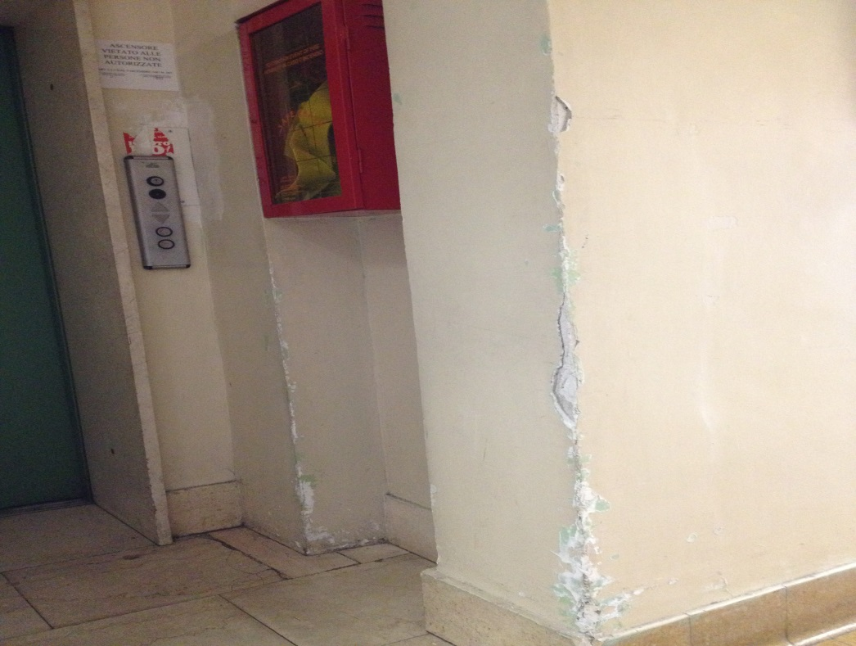

Slide 24
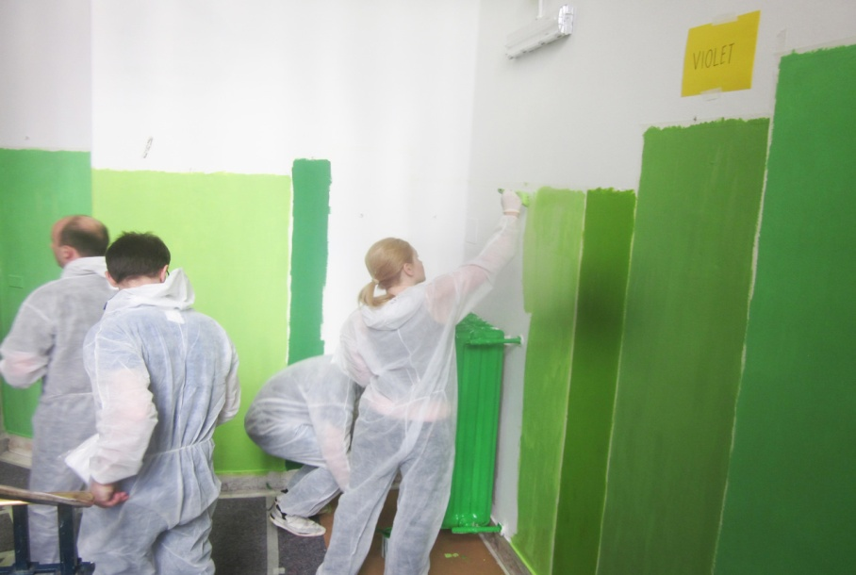
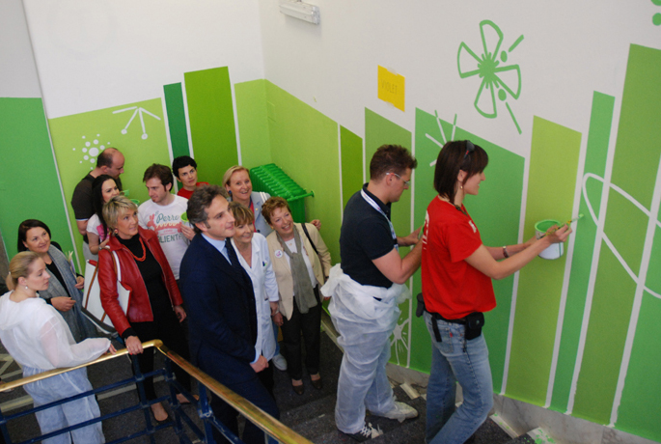
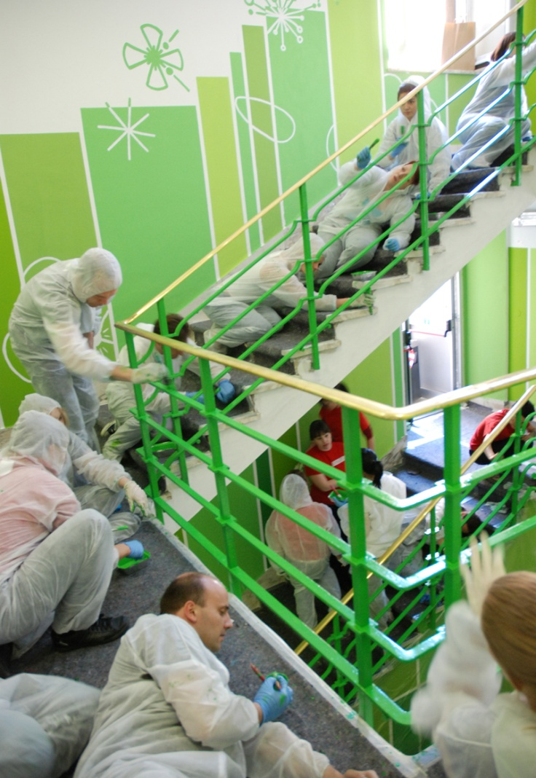
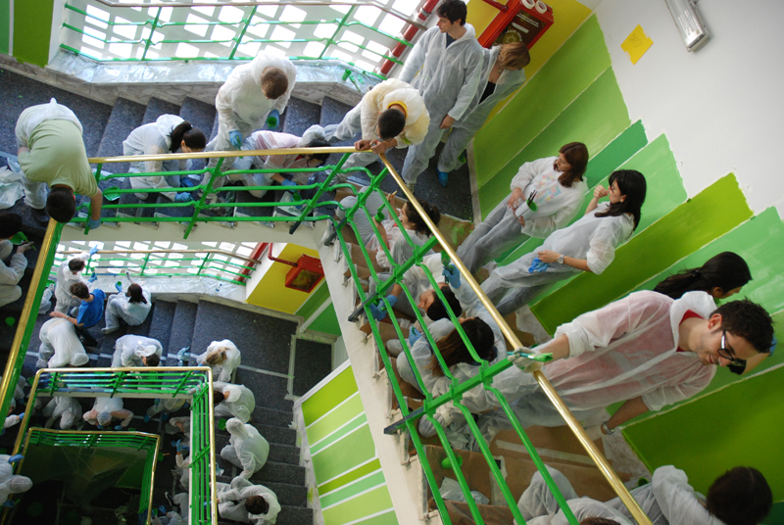
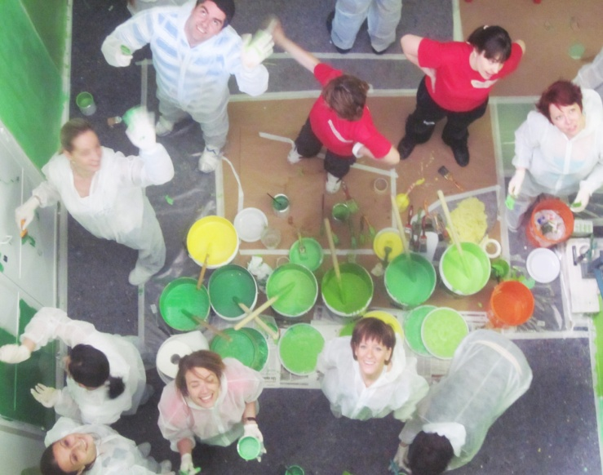

Slide 25
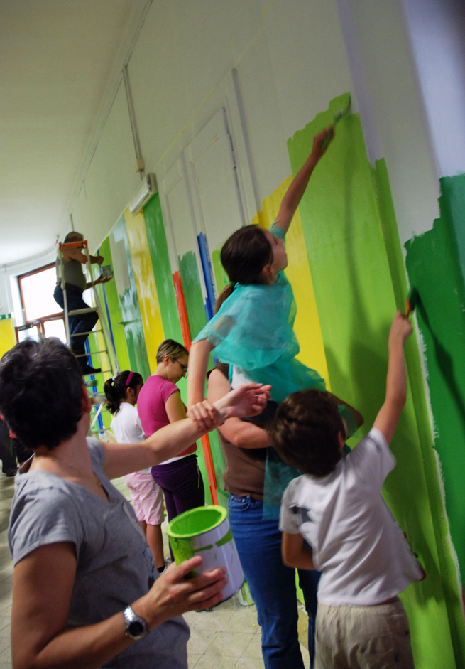
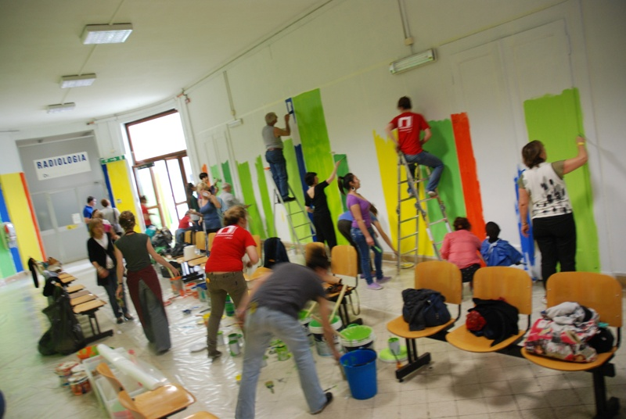
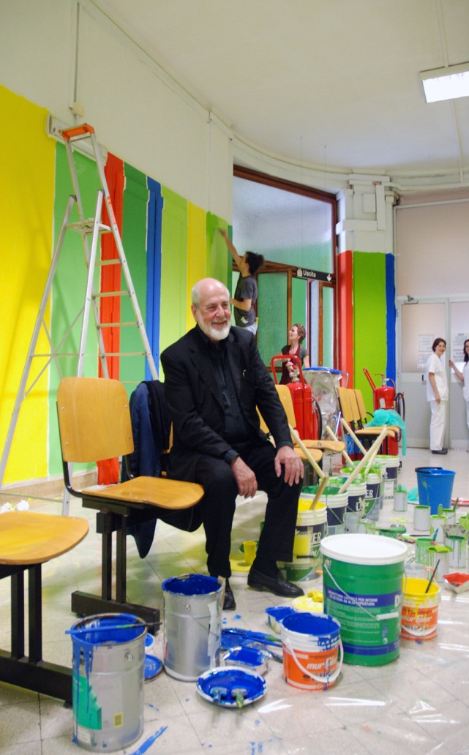
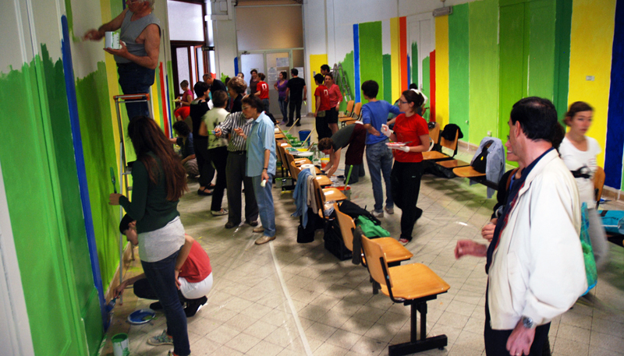
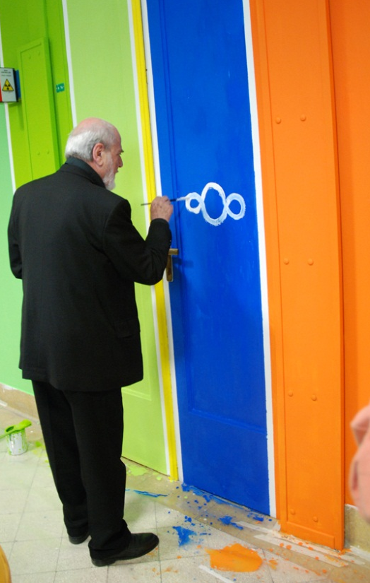

Slide 26






Slide 27






Slide 28




Slide 29


Slide 30






Slide 31


"Born with culture"
ART into LIFE from the first steps

Slide 32




Launch
23rd September 2014

